Slide 1
MICHAEL DART
T1A3 – Terminal Application Quiz App
Welcome

Slide 2
MICHAEL DART - T1A3 – Terminal Application
Introduction to the app
The application I have created is based on a multiple choice quiz for any user who wants to test their knowledge against multiple categories and levels within the app.

Slide 3
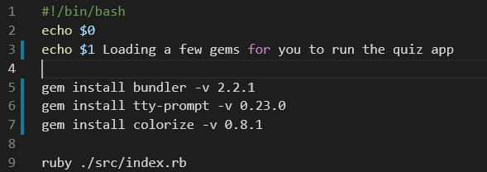
MICHAEL DART - T1A3 – Terminal Application
Before you get in…
The app doesn’t start in the app
To assist the user to run the app initially:
A script has been created helping unfamiliar Ruby users to run the app
Ruby Gems are installed when the script is initiated. (The user alerted to this by a message). This is to cover all bases, incase the User doesn’t have the Gem installed
We like to get to know the user straight away – that’s why we ask for your name ☺

Slide 4
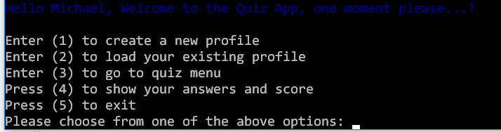
MICHAEL DART - T1A3 – Terminal Application
You’re inside now!
Welcome in!...
When inside the app you will notice the following features:
Create a profile
Load an Existing Profile
Quiz Menu
Answers and Scores Menu
Exit Option
All items are controlled within the index.rb file, with the classes separated into its own file

Slide 5
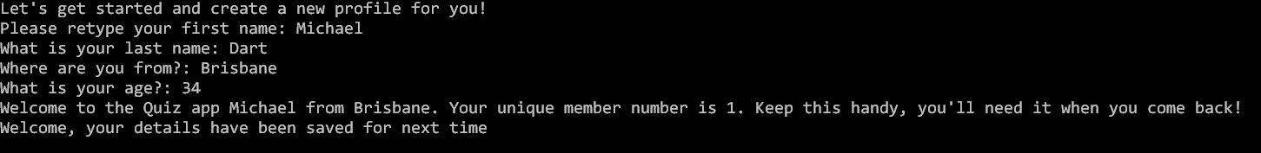
MICHAEL DART - T1A3 – Terminal Application
Let’s go a little further
More inside the app!
Create a profile
The user will be prompted with some quick questions to create a profile, identifying themselves for future access.
Once created a membership ID will be given and the user is taken back to the main menu

Slide 6
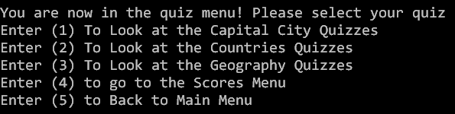
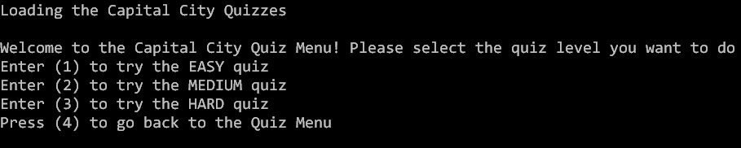
MICHAEL DART - T1A3 – Terminal Application
Time to test your knowledge…
Categories and Levels
The user can select from multiple categories to test their knowledge.
From which each category has 3 levels, Easy, Medium and Hard
They will also be able to go to the scores menu you, bypassing the need to go back to the main menu
The user is gently guided as to what is happening when an option is selected

Slide 7
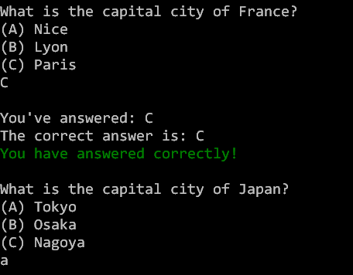
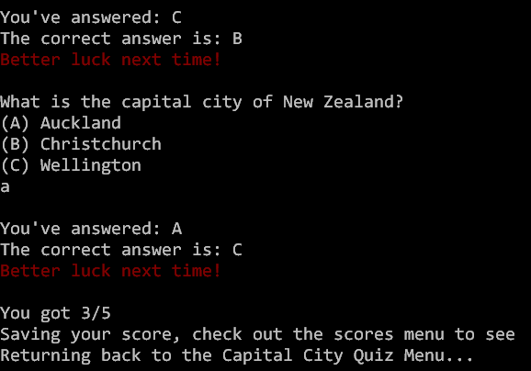
MICHAEL DART - T1A3 – Terminal Application
Taking the quiz.
The multiple choice questions will appear like so.
The app will return what the user has answered vs. what is correct
A statement is printed to the user for CORRECT and INCORRECT answers
The user will be able to answer in uppercase or lower, the app will recognise their input
A score is printed at the end to let the user know how they’ve done

Slide 8
MICHAEL DART - T1A3 – Terminal Application
Where to from here?
Additions and Fixes
Additional content – new Categories and Levels
Scores Menu – a way for the user to view what scores they have achieved
Loading the users profile – so that the user can access their details, saved quizzes and scores
Fixing the TTY Prompt in the app

Slide 9
MICHAEL DART - T1A3 – Terminal Application
THANK YOU
LIKES
CHALLENGES
The code – thinking how to best to put my ideas into code
Keeping my code as DRY as possible
Figuring out the errors
Collecting the content
Seeing how my the code works
Creating the script
GOODBYE

